Slide 1

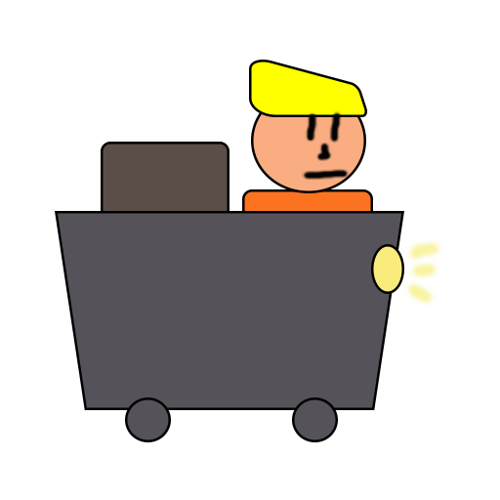
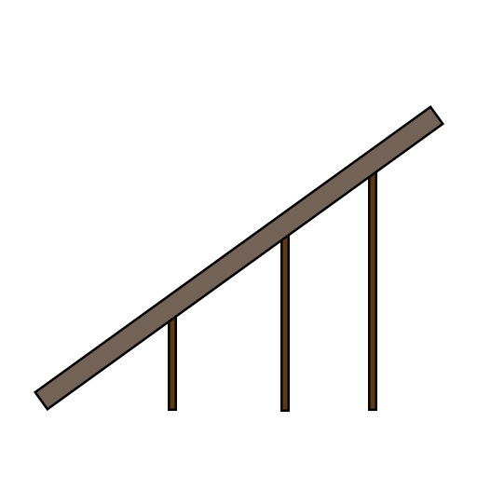
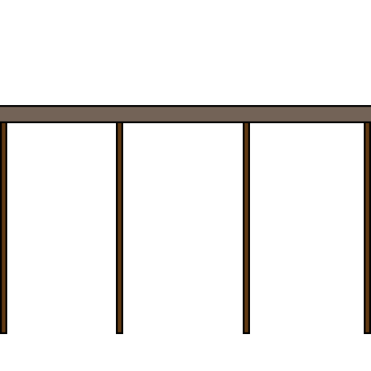
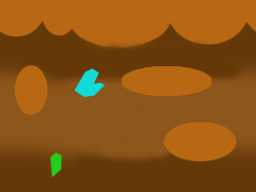
Minecart
Andrei Dumbravescu
Alpeche Pancha
Matthew Fisher

Slide 2

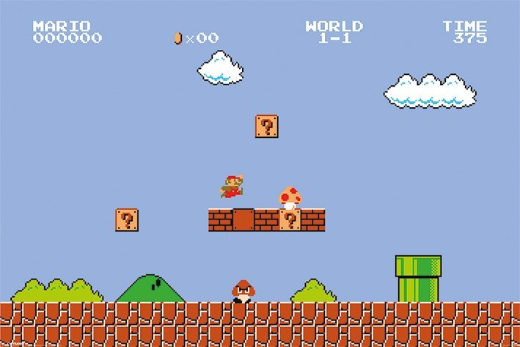
Project Brief
2D Platformer game
Replacing the Jump Mechanic with a Drag and Drop Mechanic
Player needs to have quick reaction and fast decision making

Slide 3
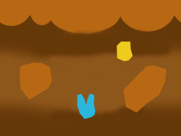
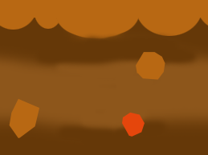

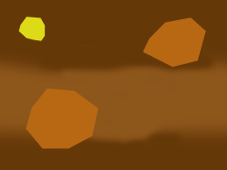
Game Loop
Minecart moves at a constant speed in a random generated level
Player places tracks on the level to avoid obstacles
The game is endless until the minecart hits an obstacle

Slide 4

Emotions
Fiero!
Building tension through constant need of fast reactions and unknowable upcoming obstacles
Release through the inevitable player death

Slide 5
Motivation
Distance tracker
Currency tracker

Slide 6

Upcoming
Random generated assets in the level
UI assets that improve the user experience
Menu screen, pause screen and end screen
Audio
Animations
Visual effects

Slide 7

Questions?

